Slide 1
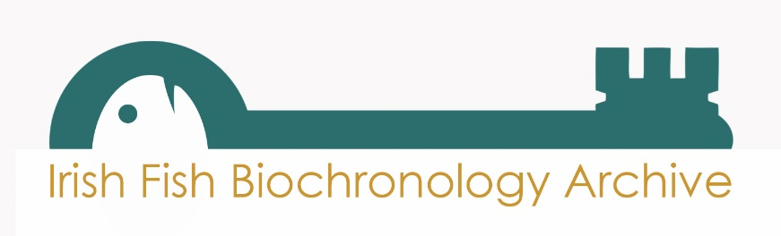
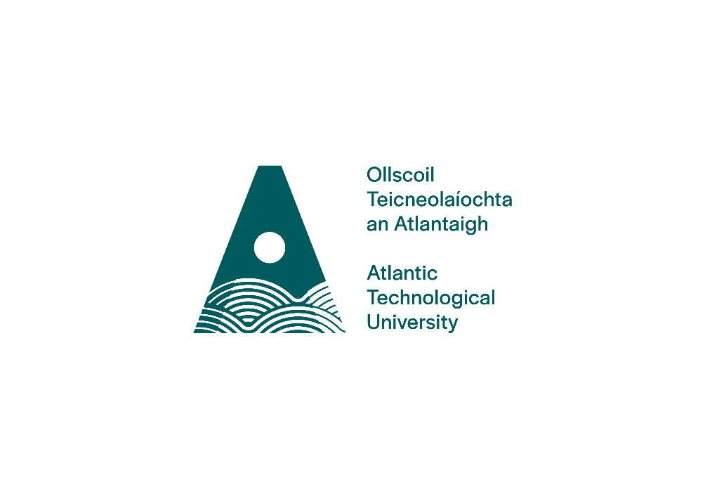
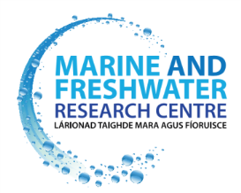

Unlocking the archive
Towards sustaining and growing IFBA beyond the unlocking the archive project
Deirdre Brophy, Marine and Freshwater Research Centre, ATU

Slide 2
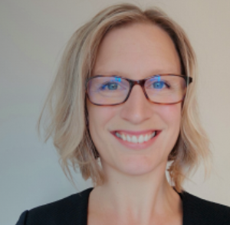

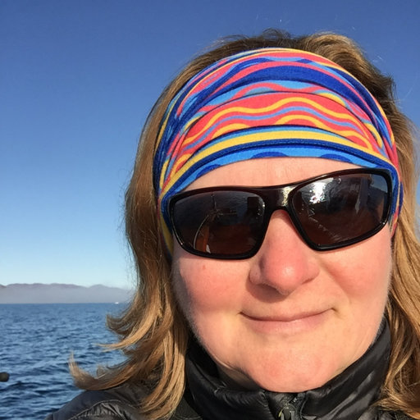

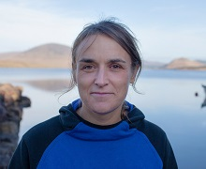
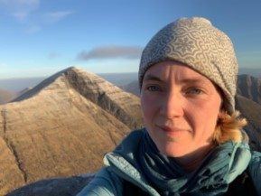


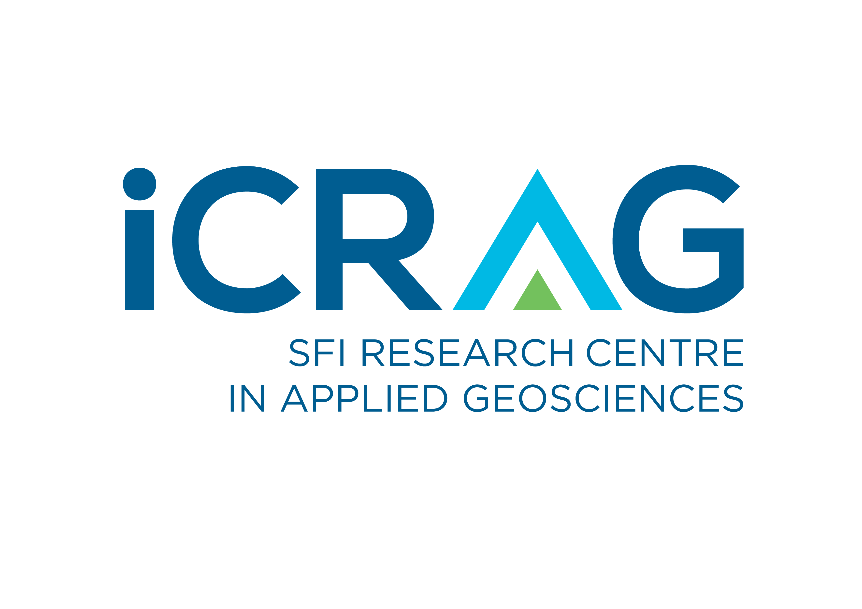
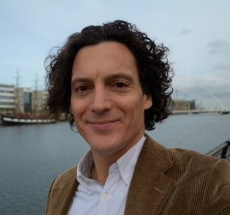
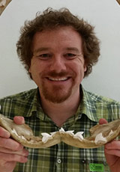

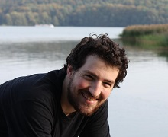

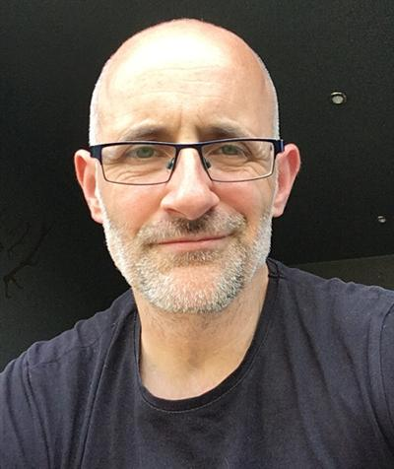

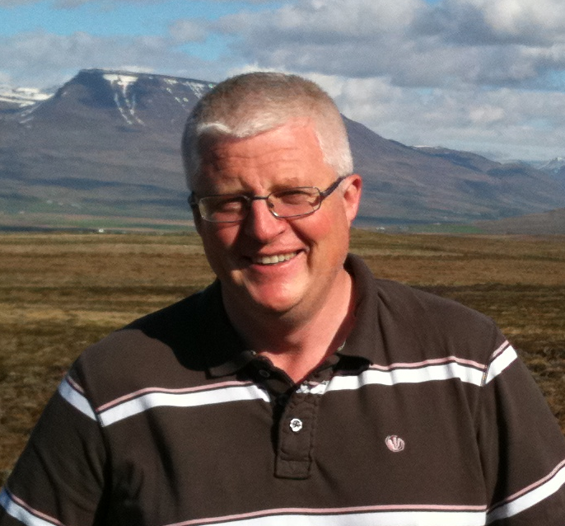
UTA Collaborations
Scale Cortisol
Scale Growth
Long-term monitoring
Martha Robertson
Anna Sturrock
Elvira D’Eyto
Nora Hanson
Scale stable isotopes
Scale chemistry: Quentin Crowley
Genetics
Brian Hayden
Tagging
Joshka Kaufmann
Deirdre Cotter
Clive Trueman
Phil McGinnity

Slide 3
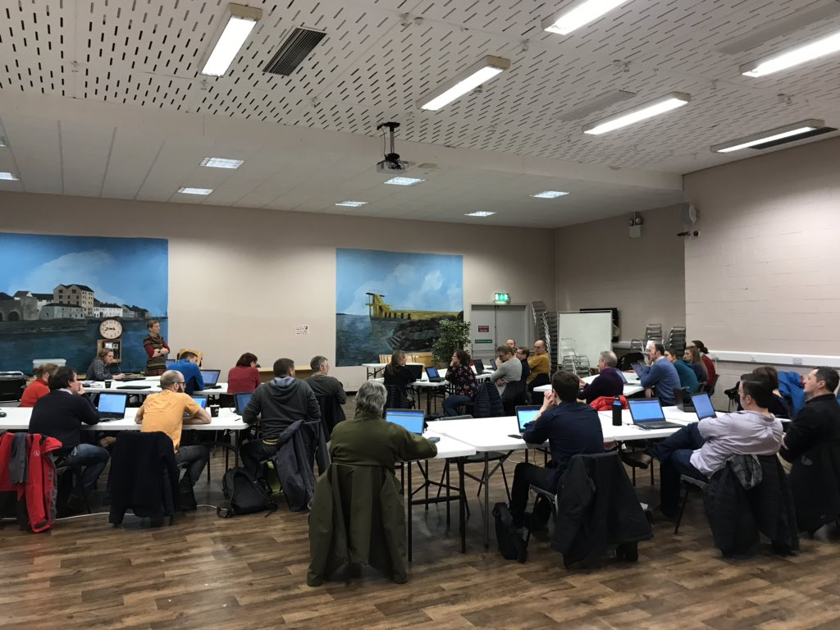
Building an International Network
ICES WKBioArc: Workshop on Scale, Otolith Biochronology Archives February 2020, Galway
30 participants from 12 countries:
“Shared a common desire to improve the storage and management of the collections and their associated data through the implementation of standardized protocols”.
International Year of the Salmon Synthesis Symposium
Theme session: Towards a Data driven Future: Progress and Future Requirements for Data Mobilization across the Salmosphere.

Slide 4
Collaborative funding proposals
ScleroNet: proposal submitted to the EU H2020 Research and Innovation Actions program (H2020-INFRAIA-2020-1). 14 partners from 8 countries (12/15, not funded)
ChemFish: SFI Frontiers for Partnership (under evaluation)
Evodyngaas: SFI-IRC (Joshka Kaufmann)
ICRAG Phd Fellowship (Quentin Crowley) (in preparation)

Slide 5
Where next?
IFBA can support research that is highly relevant to current research priorities – i.e. very fundable
This provides short-term and discontinuous support for research
Longer-term and continuous support of IFBA would leverage substantial additional support for research
Small investment relative to the value of the resource

Slide 6

Acknowledgements
This study was funded through a Grant-Aid Agreement No. PBA/FS/16/03 (unlocking the archive: using scale and otolith chronologies to resolve climate impacts) under the Marine Research Programme by the Irish Government.

